Slide 1
Nidec Corporation LTD
BFB-0025 PCBA TRACEABILITY SMT-ASSEMBLY
Builder: NPCV-SHTP-FA
Date: 15thMay 2023
Updated: 19thMay 2023

Slide 2




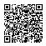
Layout Data
z
Lasez Maker
soldering printer
SPI machine
AoI machine
Inspection
Pallet/
equipment
Barcode 2D C
Barcode 2D A
Server Log
postgresql
User/UI
Barcode 2D B
Barcode 2D B
Closed
Checking BOX ID
Assy PCB into Cover
Cutting

Slide 3
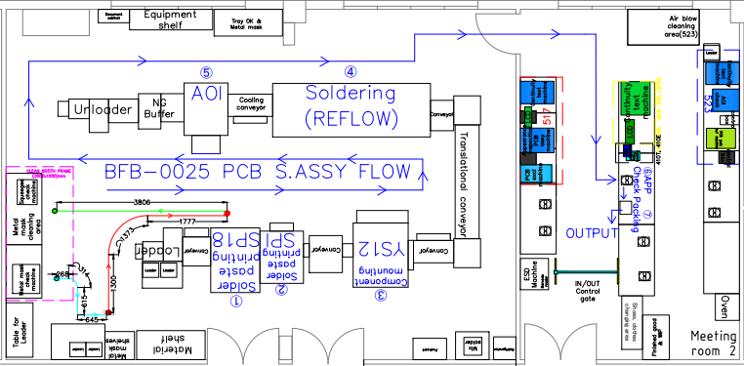
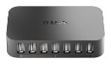
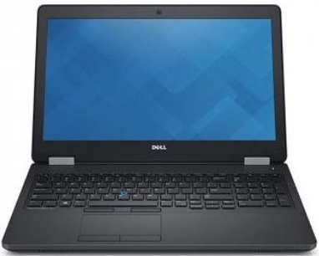
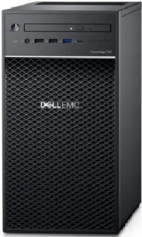
Layout Data
LAN HUB
AOI MC
HOST PC 2PCS

Slide 4
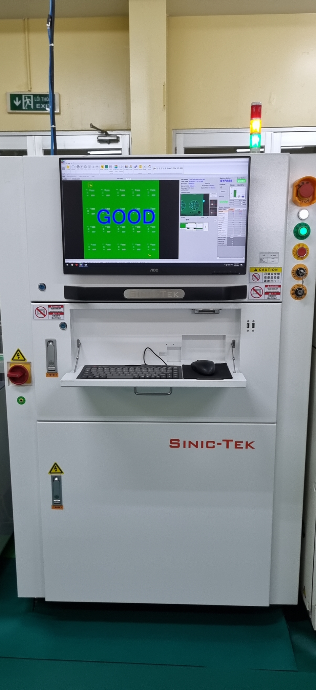
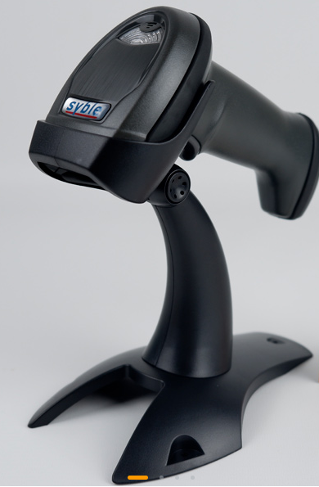
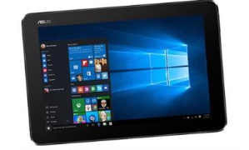
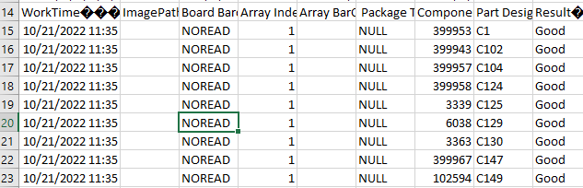
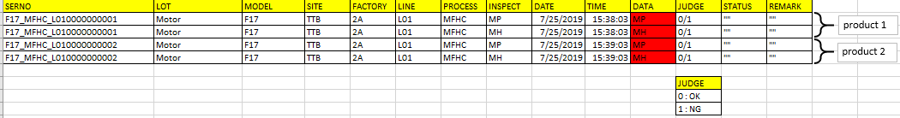
SPI Machine Station
PQM DB
Tool 01: Converter application
No | Equipment/tool | Qty | Remake | Maker
1 | Barcode reader | 1 | USB connect | Nidec
2 | Tablet/PC | 1 | In the case, win 10 tablet is best chosen. | Nidec
3 | Tool 01: Converter application | 1 | Convert csv machine file to PQM DB data form | VN vendor
4 | Export realtime data tool | 1 | Export data from machine to PC on realtime | China vendor

Slide 5
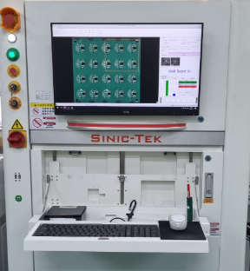
AoI Machine Station
PQM DB
Tool 02: Converter application
No | Equipment/tool | Qty | Remake | Maker
1 | Barcode reader | 1 | USB connect | Nidec
2 | Tablet/PC | 1 | In the case, win 10 tablet is best chosen. | Nidec
3 | Tool 02: Converter application | 1 | Convert csv machine file to PQM DB data form | VN vendor
4 | Export realtime data tool | 1 | Export data from machine to PC on realtime | China vendor

Slide 6
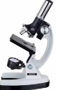
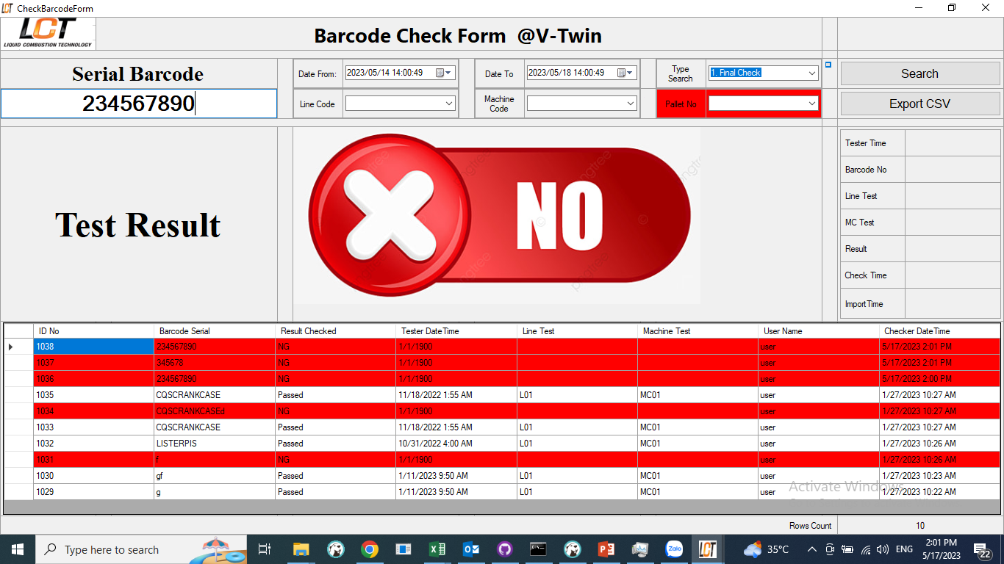
Final Inspection Station
Order DB
PQM DB
Get before station data update data to PQM
Connection tool
No | Equipment/tool | Qty | Remake | Maker
1 | Barcode reader | 1 | USB connect | Nidec
2 | Tablet/PC | 1 | In the case, win 10 tablet is best chosen. | Nidec
3 | Tool 03: UI on client. | 1 | Checking data all before station (OK, NG status) Updating the status of current station in DB. Define NG position (sub PCB) on main PCB by color Creating PCB status layout, used for next station. | VN vendor

Slide 7
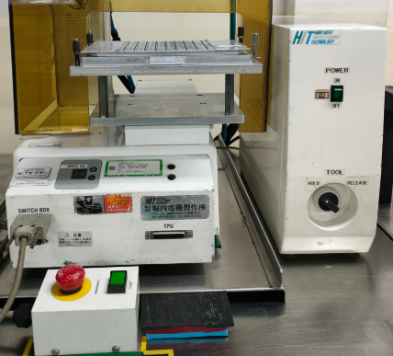
PCB Cutting Station
Order DB
PQM DB
Get before station data update data to PQM
Connection tool
Before cutting
After cutting
Cutting
Cutting
No | Equipment/tool | Qty | Remake | Maker
1 | Barcode reader | 1 | USB connected | Nidec
2 | Tablet/PC | 1 | In the case, win 10 tablet is best chosen. | Nidec
3 | Tool 04: UI on client. | 1 | Checking data all before station (OK, NG status) Showing NG position (sub PCB) on main PCB layout Count sub PCB OK product Double NG check by compare PCB after cutting with Layout after checking barcode | VN vendor

Slide 8
PCB Cutting Station
Order DB
PQM DB
Get before station data update data to PQM
Connection tool
Before cutting
After cutting
Cutting
Cutting
No | Equipment/tool | Qty | Remake | Maker
1 | Barcode reader | 1 | USB connected | Nidec
2 | Tablet/PC | 1 | In the case, win 10 tablet is best chosen. | Nidec
3 | Tool 04: UI on client. | 1 | Checking data all before station (OK, NG status) Showing NG position (sub PCB) on main PCB layout Count sub PCB OK product, NG product. Double NG check by compare PCB after cutting with Layout after checking barcode | VN vendor

Slide 9
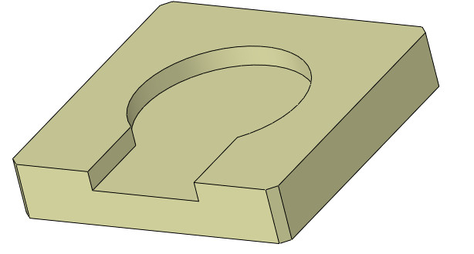
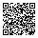

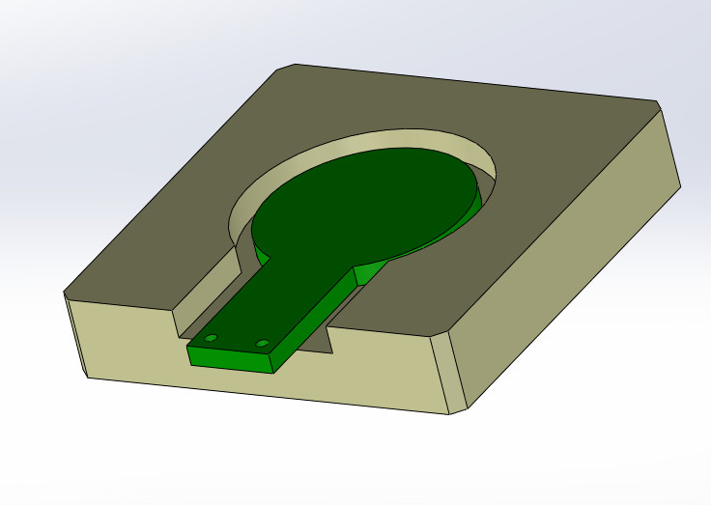
Assy PCB into Cover
PQM DB
Get before station data update data to PQM
Sub PCB
Cover
Product
No | Equipment/tool | Qty | Remake | Maker
1 | Barcode reader | 1 | USB connected | Nidec
2 | Tablet/PC | 1 | In the case, win 10 tablet is best chosen. | Nidec
3 | Tool 05: UI on client. | 1 | Create new barcode, it is barcode product Count OK product | VN vendor

Slide 10
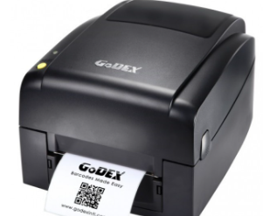
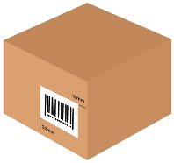
PCB Box ID
Other DB
Get before station data update data to PQM
No | Equipment/tool | Qty | Remake | Maker
1 | Barcode reader | 1 | USB connected | Nidec
2 | Tablet/PC | 1 | In the case, win 10 tablet is best chosen. | Nidec
3 | Printer label | 1 | USB connected
4 | Tool 06: Box ID tool and recheck data. | 1 | Recheck data from previous stage PQM. Packing and add lot ID Create a link between product barcode and shipment barcode → Support to retrieve original data when there is a problem at the customer | VN vendor

Slide 11
Checker pallet/frame at soldering printer
Washing Machine
Order DB
Soldering printer
Pallet
Connection tool
Connection tool
Pallet
No | Equipment/tool | Qty | Remake | Maker
1 | Barcode reader | 1 | USB connected | Nidec
2 | Tablet/PC | 1 | In the case, win 10 tablet is best chosen. | Nidec
3 | Tool 07: Check pallet/frame status | 1 | In Washing machine: Check pallet after cleaning. In soldering printer station: Check Pallet is already cleaned. Link between products in soldering printer station and pallet No | VN vendor

Slide 12
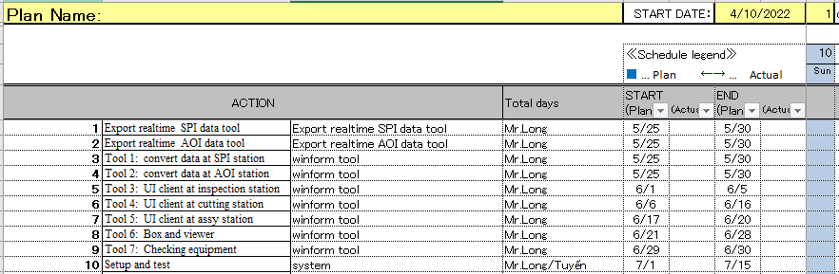
Equipment List
No | Equipment/tool | Qty | Model/ Code ref | Station | Remake
1 | Barcode reader | 7 | HONEYWELL 1450G ĐỌC 2D | All | USB connected
2 | Tablet/PC | 7 |  | All | win 10 tablet is best chosen. And usb connected, WLan card connected is stronger
3 | Printer label | 1 | LK B10 | BOX ID | USB connected
Planning

